Slide 1
GPS Revision
Click i button for each topic.
Sentence Types
Direct Speech
Semicolons and colons
Tenses
Clauses
Brackets, Dashes and Hyphens
Subjunctive
Active and Passive
Word Classes
Apostrophes
Expanded Noun Phrases

Slide 2
Sentence Types

Slide 3
Sentence Types
What actions could we do for each sentence?
Statement
Is a fact or opinion. Usually ends with a full stop. The sky is blue.
Command
Uses an imperative verb. Can end with a full stop or an exclamation mark. Stir the sauce.
Question
Ends in a question mark. Will often start with a question word. What is the time?
Exclamation
Always starts with HOW or WHAT, ends with an exclamation mark, and boots the verb to the end. What fun this is! How kind you are!

Slide 4
Sentence Types
 | Command | Statement
You must do your homework. |  | X
First, stir the ingredients. | X
Sit down quietly. | X
It is important that you sit down. |  | X
Later, go home with Bob. | X
Look for the imperative verbs!
They don’t have a subject, they just boss you about!

Slide 5
Sentence Types
 | Exclamation | Question
How wonderful this is! | X
What a day! | X
How are you? |  | X
How difficult was that test? |  | X
How difficult that test was!
Exclamations start with how or what and boot the verb to the end.
If you are asking something, you will need a question mark.

Slide 6
Tenses

Slide 7
Allow us all to blow your senses With Simple, Perfect and Progressive tenses There’s JUST ONE WORD in the simple present He plays, he runs, he speaks (how pleasant) Present perfect uses have or has He has run, he has spoken, he has played some jazz Present progressive is ‘is’ then i-n-g He is running, he is speaking he is playing happily Simple past is JUST ONE WORD He played, he ran, he spoke, he heard Past perfect means it happened before Uses had: he had run, he had spoken and more Past progressive (i-n-g) says the action keeps going Uses was: he was running, he was playing, he was knowing So now you all can be impressive, With simple, perfect and progressive!
Tenses Rap

Slide 8
I say progressive, you say progressing Progressive (progressing) Look for the i-n-g!
Progressive
Perfect
Harry Styles has perfect hair!
Ha ha ha!
Has have had!

Slide 9
Miss Thomas is happy today. She skips around the classroom. She plays the ukulele and speaks in a bright, upbeat voice. This is written in simple present. There is only one verb.
We are going to learn about three types of tense: simple, perfect and progressive. ONE VERB TWO VERBS Simple Perfect Progressive

Slide 10
Step 1: Present or past?
Step 2:ONE VERB TWO VERBS Simple Perfect Progressive
Look at the first verb!
I
played
football.
simple
past
I
have
played
football.
perfect
present
always look at the first verb – the auxiliary verb

Slide 11
Step 1: Present or past?
Step 2:ONE VERB TWO VERBS Simple Perfect Progressive
Look at the first verb!
I
play
football.
simple
present
I
am
playing
football.
present
progressive
always look at the first verb – the auxiliary verb

Slide 12
Step 1: Present or past?
Step 2:ONE VERB TWO VERBS Simple Perfect Progressive
Look at the first verb!
I
was
playing
football.
past
progressive
always look at the first verb – the auxiliary verb
I
had
played
football.
past
perfect
always look at the first verb – the auxiliary verb

Slide 13
The Subjunctive

Slide 14
The Subjunctive The subjunctive is not a tense, but a ‘mood’. In English we only have a few rare occasions when we need to use it:
When we’re talking about something hypothetical (including a wish):
If I were a boy
I wish I were a rock star
If she were to work harder, she would succeed.
TIP: Look out for the words if or wish – then you know you need to use the subjunctive!

Slide 15
The Subjunctive
TIP: You might recognise these verbs as imperatives (bossy verbs!)
2. The ‘bossy’ or mandatory subjunctive:
We require that he return the money.
The Prime Minister expects that each teacher work hard.
It is required that each child sit a SATs paper.
I demand that the cat be returned to its owner.
I suggest that he study.
This is often for formal occasions.
Write two bossy subjunctive sentences!
Underline your verb.

Slide 16
The Subjunctive
3. The formulaic subjunctive (for set phrases):
Long live the Queen!
God save the Queen!
Heaven help us.
Heaven forbid.
Be that as it may.
God bless you.
It conveys the meaning of ‘let’ or ‘may’.

Slide 17
Word Classes

Slide 18
Nouns Bob, table, Australia, hunger, January, happiness... A noun is a naming word for a person, place, thing or idea. (A noun is a thing, noun noun noun)

Slide 19
Proper nouns are names, places or dates: February, Brazil, Bob, Monday, Queen Elizabeth, Christianity, Islam... Common nouns are real things (even if you can’t see them): table, mud, buttons, mountain, hat, teacher, sky, monkeys... Abstract nouns are ideas or concepts: education, friendship, happiness, beauty, curiosity... Collective nouns are for groups: flock, herd, pack, team, swarm, crowd...

Slide 20
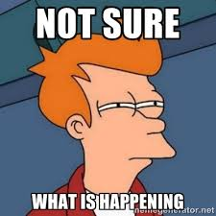
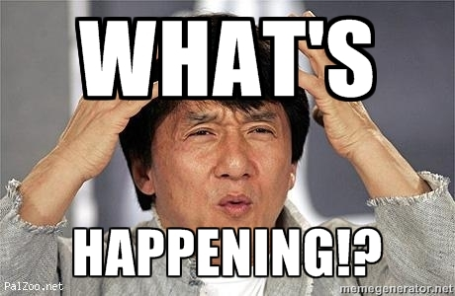
Verbs
Verbs tell us what’s happening. They are doing or being words.

Slide 21
Helping verbs before a main verb are called auxiliary verbs. Modal auxiliary verbs (will, can, could, would, should) tell us how possible the verb is. I will play chess later. “To have” or “to be” verbs can make the perfect or progressive tenses. Bob is building a rocket; Betty had built one earlier.

Slide 22
Modal Verbs Modal verbs are auxiliary (helping) verbs that tell us how likely the main verb is to happen. I will work hard I might read I should sleep
Remember,
Oh, you lucky duck spelling
O – U – L – D
Could
Would
Should

Slide 23
Modal March Can and could and will and would Must may might and shall and should Modal verbs can help you see Degrees of possibility

Slide 24
Adjectives Gargantuan, imposing, quiet, red, interesting... An adjective describes a noun. (An adjective adds to a noun)

Slide 25
Adverbs HOW: Slowly, hesitantly, confidently, well, WHEN: Soon, Later, Next An adverbial adds to a verb, telling you how, when or where the verb happens. An adverb means one word. A fronted adverbial is at the start of a sentence.

Slide 26
Prepositions
Prepositions tell you how nouns are related to each other. They might tell you where things are or when things happen. Prepositions position nouns in time and place.

Slide 27
Preposition Hokey Cokey Your preposition's in Your preposition's out after before on under, behind, inside and out They tell us when and where things are Position things and that's what it's all about!

Slide 28
Conjunctions
Conjunctions are words or phrases which link words or clauses together. Coodinating:
Subordinating:
Yet, And, But, Or, So (YABOS) connect independent (main) clauses. We do not start sentences with them.
(I SAW A WABUB) If, since, as, when, although, whilst, after, before, unless/until, because (connect subordinate clauses that do not make sense by themselves).

Slide 29
Prepositions position things/nouns
 | Preposition | Subordinating Conjunction
Before lunch, I wash my hands. | X
Before I eat, I wash my hands. |  | X
After three o’clock, I read a story. | X
After I read, I go home. |  | X
I read until home time. | X
Look for the nouns and verbs!
Prepositions position things so there won’t be a verb
Subordinating conjunctions create clauses so there will be a verb

Slide 30
Pronouns A pronoun replaces a noun to stop you repeating the noun over and over again. Bob said Bob would bring the doughnuts but Bob forgot the doughnuts. Bob was unhappy about the situation.
Bob said he would bring the doughnuts but he forgot them. He was unhappy about it.

Slide 31
Pronouns Relative pronouns still replace a noun but introduce a relative clause I have a book which is my favourite ‘which’ replaces ‘book’ Miss Thomas, who was walking carefully, grinned. ‘who’ replaces ‘Miss Thomas’

Slide 32
Determiners Determiners are words which introduce a noun. They tell us which noun we’re talking about. Which book? the book/this book/that book/his book/its book/your book/one book/no book

Slide 33
Types of determiners
Articles
Demonstratives
Possessives
Quantifiers

Slide 34
1. Articles
There are two kinds of articles: the definite article (the) and the indefinite article (a or an)
Nouns can be found with or without articles.
Dogs need to be walked every day. (no determiner)
The dogs need to be walked every day.
A dog needs to be walked every day.

Slide 35
2. Demonstratives
There are four demonstratives: this, that, these and those.
For these words to act as determiners, they must be in front of a noun.
If the word is in front of a verb, it’s a pronoun.
That porridge was delicious. (That is a determiner)
That was delicious. (That is a pronoun)
Those people were so rude! (Those is a determiner)
Those were awful. (Those is a pronoun)

Slide 36
3. Possessive determiners
My, your, his, her, its, our and their, before a noun, will be possessive determiners.
Mine, yours, his, hers, its, ours and theirs, on their own, are possessive pronouns not determiners.
My writing is neater than yours.
The dog ate its food quickly.
His class are so lazy.
Her singing was more tuneful than his.
Their team beat ours.
It’s not their fault her coat got lost.
determiners

Slide 37
4. Quantifier determiners – how many or how much of something.
Numbers or amounts before a noun are quantifier determiners.
I ate six biscuits.
The flat’s on the sixth floor.
I saw two-thousand ants.
There were no apples left.
There were several pears.

Slide 38
Expanded Noun Phrases

Slide 39
rain
Noun

Slide 40
The rain
Noun Phrase
Determiner + Noun

Slide 41
The angry rain
Expanded Noun Phrase
Determiner + Adjective + Noun

Slide 42
Adjectives
Choose a noun, add a determiner and add two adjectives to describe it.
Is this a sentence?
(no)
The relentless, angry rain
Expanded noun phrase – a phrase with a noun and at least one adjective.

Slide 43
An easy way to write a strong noun phrase is do the noun phrase march:
(determiner adjective adjective noun prepositional phrase)
an adjective adjective noun with adjective adjective noun
an ominous abandoned building with decaying Victorian bricks
a bespectacled elderly man with an old-fashioned battered suitcase
an idyllic German village with an imposing, mysterious clocktower

Slide 44
Direct Speech

Slide 45
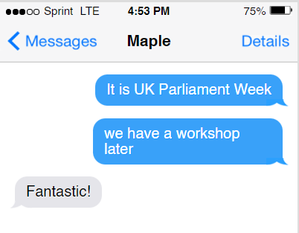
“it is UK Parliament Week”. Announced Miss Thomas brightly, “we have a workshop later” “fantastic” Said the class.
“It is UK Parliament Week,” announced Miss Thomas brightly, “We have a workshop later.”
“Fantastic!” said the class.

Slide 46
Clauses

Slide 47
Clauses have verbs. Phrases do not.

Slide 48
Phrase or Clause? 1. The doctor’s practice was a long way from her house. 2. Slowly, the enormous turnip grew and grew. 3. For months and months the students studied hard. 4. The sheep were led to the field. 5. There is a gigantic spider under that chair! 6. Under the sea live all kinds of animals. 7. Over the weekend I went shopping. 8. I always have a biscuit and cup of tea at five o’clock. 9. Next year, we’re going on an adventure.
phrase
(adverbial)
clause
Verb = grew
phrase
(adverbial)
clause
Verbs = were led
clause
Verb = is
clause
Verb = live
phrase
(adverbial)
phrase
(adverbial)
clause
Verb = are (‘re) going
Find the verbs!

Slide 49
Main Clauses
The rain
hammered the pavement
.
subject
verb
object
The sun
shone brightly
.
subject
verb
They are independent clauses which make sense on their own.

Slide 50
Amy took the dog for a walk and it became very dirty.
coordinating conjunction
.
subject
verb
object
subject
verb
I can join my two main/independent clauses together with a coordinating conjunction.
If I took away my coordinating conjunction, these main clauses would still make sense on their own.
Two verbs, two clauses.

Slide 51
YABOS yet and but or so
Co-ordinating Conjunctions
Combine main clauses.
You can use a semicolon instead.
I like apples and I like pears.
I like apples; I like pears.
I like apples but the green ones are best.
I like apples; the green ones are best.

Slide 52
Subordinate clauses
As the busy traffic surged through the city,
whilst the sea lapped the sides of my boat.
Do they make sense on their own? (No)
What do they start with? (A subordinating conjunction)

Slide 53
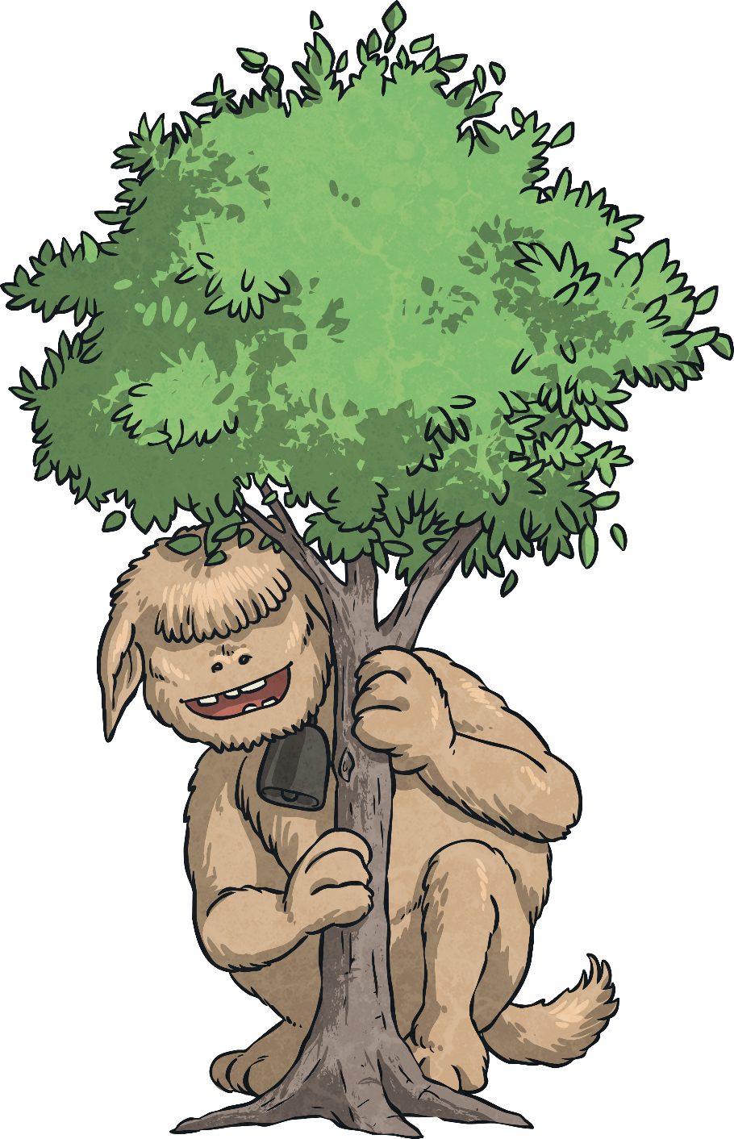
Subordinating Conjunctions
I
SAW
A
WABUB

Slide 54
Subordinating Conjunctions
I If
SAW Since, As, Whilst
A Although
WABUB When, After, Before, Unless/Until, Because
(There are many more)

Slide 55
As the busy traffic surged through the city,
the rain
hammered the pavement
.
The sun
shone brightly
whilst the sea lapped the sides of my boat
.
A subordinate clause adds to a main clause.

Slide 56
What are these?
The bag
was on the boy’s back
.
Miss Thomas
used Microsoft Teams
.
Main Clauses
How do you know?
They make sense by themselves and they contain a verb.

Slide 57
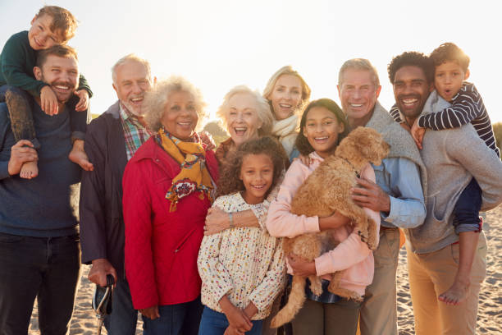
What are these?
which was soaked from the rain
who taught Maple class
relative clauses
Do they make sense on their own? (no, so they are subordinate clauses)
What do they start with? (a relative pronoun – who, which)

Slide 58
Relative clauses can be separated using commas.
The bag
,
which was soaked from the rain
,
was on the boy’s back
.
Miss Thomas
,
who taught Maple class
,
used Microsoft Teams
.

Slide 59
Relative clauses can be embedded
Miss Thomas
,
who taught Maple class
,
used Microsoft Teams
.
or after a main clause.
Miss Thomas
used Microsoft Teams
,
which was a challenge
.

Slide 60
Clauses
main clause
the rain
hammered the pavement
subordinate clause
as the sun rose
relative clause
which was in Gotham

Slide 61
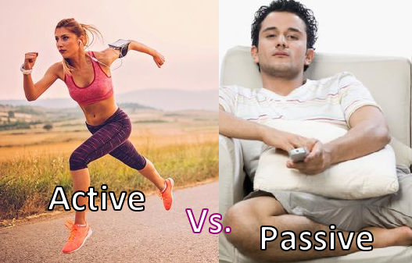
Active and Passive

Slide 62
What are these?
The bag
was on the boy’s back
.
Main clauses
Miss Thomas
used Microsoft Teams
.
How do you know?
They make sense on their own

Slide 63
The subject does the verb!
the children
The teacher
helped
.
Subject
Verb
Object
chased
The zombies
the children
.
Subject
Verb
Object
The object is affected by the verb.

Slide 64
Active sentences focus on who: Miss Thomas cooked the meal. Passive sentences focus on what: We swap it round. The meal was cooked by Miss Thomas.
Miss Thomas is doing the cooking! It’s active.
Active:
The meal isn’t doing any of the cooking! It’s passive.
Passive:

Slide 65
Passive sentences use an auxiliary (helping verb) before the main verb. The meal was cooked by Miss Thomas.
auxiliary verb
main verb

Slide 66
Bob
liked
Betty
.
Active
Betty
was liked by
Bob
.
Passive
The bluchers
surrounded
the building
.
Active
The building
was surrounded by
the bluchers
.
Passive
Bob
passed
the shops
.
Active
The shops
were passed by
Bob
.
Passive

Slide 67
The Zombie Check
Sometimes you can test if a verb is passive by adding “by zombies” after the verb. The boy was stopped [by zombies]. This makes sense, so this is a passive sentence. The boy stopped [by zombies]. This does not make sense, so this an active sentence.

Slide 68
Apostrophes

Slide 69
Apostrophes GOLDEN RULE: Apostrophes only have TWO jobs: 1. to show omission 2. to show possession Apostrophes never make plural!

Slide 70
Job 1: Omission When an apostrophe replaces missing letters. These are most common in contractions: I + am → I’m (replaces the a) Contractions are informal.

Slide 73
Remember: do not join where an apostrophe takes the place of a letter: don ’ t
Contractions
aren’t
can’t
couldn’t
didn’t
doesn’t
don’t
she’ll
hasn’t
he’ll
he’s
I’d
I’m
It’s
I’ve
mightn’t
mustn’t
she’s
that’s
there’s
they’ll
they’re
we’d
we’ve
weren’t
what’s
where’s
we’ll
who’s
who’ve
wouldn’t
you’d
you’re
you’ve

Slide 74
Job 2: Possession When an apostrophe shows ownership. E.g. Ben’s car The apostrophe s shows Ben owns the car. The boy’s work Whose work is it? The boy’s.
Remember, our rule is “word first, then apostrophe”

Slide 75
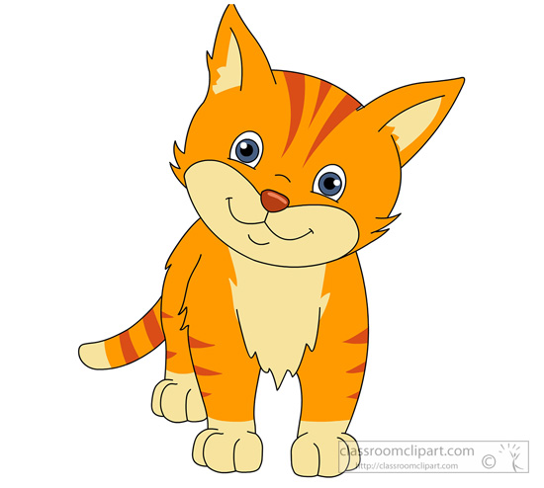
Top Tip: Write the word first, then think about if you need an apostrophe.
toy
The cat
“word first, then apostrophe”

Slide 76
The cat’s toy
Look at the word first (cat – only one of them!) ’s to show possession
“word first, then apostrophe”

Slide 77
The cats
toy
“word first, then apostrophe”

Slide 78
The cats ’ toy
Look at the word first (cats– more than one of them!) ’ to show possession
“word first, then apostrophe”

Slide 79
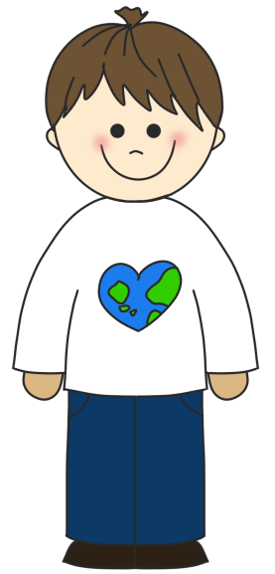
The children
toy
“word first, then apostrophe”

Slide 80
The children’s toy
Look at the word first (children) ’s to show possession
“word first, then apostrophe”

Slide 81
Apostrophes only have two jobs:
1. Omission
have + not → haven’t
“I’m off t’shops!” “Yer a wizard, ‘arry,” said Hagrid.
Letters are missing
(taking the place of t[o the] shops)
Letters are missing
(taking the place of [H] in Harry)

Slide 82
Is this showing omission (missing out letters)?
Is this showing possession (ownership)?
I put tomatoe’s in my salad.
I bought some DVD’s.
I will try hard in my SAT’s.
NO so there should NOT be an apostrophe.
Tomatoes
DVDs
SATs
Apostrophes NEVER make plural!

Slide 83
it’s and its
contraction
determiner
We only use an apostrophe for it is or it has (contraction).
I watch television because it’s great (it is)
The dog chased its tail (possessive determiner)

Slide 84
you’re and your
contraction
determiner
We only use an apostrophe for you are (contraction).
Every day you’re working hard (you are)
Every day you do your work (possessive determiner)

Slide 85
who’s and whose
contraction
determiner
We only use an apostrophe for who is or who has (contraction).
I see Bob who’s a teacher. (who is)
Bob whose class it is (determiner)
Whose book is this? (determiner)

Slide 86
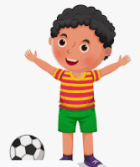
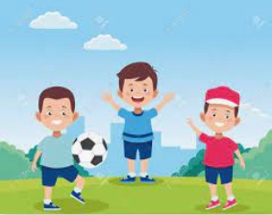
Task Use apostrophes to correctly show possession.
Word first, then apostrophe

Slide 87
Task Use apostrophes to correctly show possession.
Word first, then apostrophe
The boy
The girl
’s
’s
ball
computer
It belongs to the boy
It belongs to the girl
The boys
’
The girls
’
ball
computer
It belongs to the boys
It belongs to the girls

Slide 88
Semicolons and Colons

Slide 89
Semicolons (between two main clauses)
Semicolons can be used instead of full stops.
They separate parts of a sentence that could make sense by themselves but are linked together.
I like pizza. The tomato sauce is delicious.
I like pizza; the tomato sauce is delicious.
These are two independent (main) clauses that are relevant to each other.
Think of your semicolon like a knife; you are chopping your sentence in half.

Slide 90
Semicolons
If items in a list are long items, we might also use a semicolon instead of a comma to avoid confusion.
Our school is known for the quality of the teaching, especially in English; the healthy and appealing food; the intelligence and helpfulness of the students; and its beautiful field.

Slide 91
Colons (after a main clause)
They are the “ta daaah!” of punctuation. They are just about to show you something!
Colons can be used to introduce lists.
These are the things I bought: apples, pears and bananas.
Colons should only be used if the clause before it makes sense on its own.
E.g. You will need apples , pears and bananas.
This is one main, independent clause so don’t interrupt it with a colon.
I like some fruit: apples, pears and bananas.
‘I like some fruit’ is a main/independent clause which makes sense on its own.

Slide 92
Colons (after a main clause)
A colon can also be used to introduce an explanation, definition or quote.
I’ll tell you what I’m going to do: I’m going to quit.
Elephant: a large grey mammal.
In Scene 5, Romeo confesses his love: “Juliet I love you.”
Remember, they are the “ta daaah!” of punctuation. They are just about to show you something!

Slide 93
Colons (after a main clause)
The first clause must make sense on its own and the second clause must add information about the first clause.
I’ll tell you what I’m going to do: I’m going to quit.
Michael had a problem: he did not know how to sit on the chair.

Slide 94
Colons vs. Semicolons How does the punctuation change the meaning?
The mouse was playing; the cat was asleep.
The mouse was playing: the cat was asleep.
The semicolon means they are separate statements.
The mouse was playing and the cat was asleep.
The colon means that they are connected.
The mouse was playing because the cat was asleep.

Slide 95
Colons vs. Semicolons
How does the punctuation here change the meaning?
I was irritated; I dropped my dinner.
I was irritated: I dropped my dinner.
because
The dog was on the sofa; its owners were out.
The dog was on the sofa: its owners were out.
because
The dog was happy; it found a bone.
The dog was happy: it found a bone.
because

Slide 96
Brackets, Dashes and Hyphens

Slide 97
Brackets
Brackets separate extra information in a sentence.
If you were to take the brackets away, the sentence would make sense.
They’re always used in pairs.
Marco (a farmer) had lost all of his sheep except one.
The farmer cried all the way home (he’d lost his sheep).
The sheep had escaped from the field (there was a gap in the fence).
This full stop refers to the sentence not the information inside the bracket, so goes outside of the bracket.

Slide 98
Write the sentence which uses brackets correctly:
(Graham my uncle) loves smoked salmon.
Graham my uncle (loves smoked) salmon.
Graham (my uncle loves) smoked salmon.
Graham (my uncle) loves smoked salmon.
Extra information you can take out is called parenthesis.

Slide 99
Dashes
Dashes can do the same job as brackets (parenthesis):
The dogs – Tess and Bob – loved playing fetch.
The dogs (Tess and Bob) loved playing fetch.
It can also separate two main clauses with a long pause:
Bob looked over the bridge – there was a huge drop.

Slide 100
Dashes
Dashes can also show interruption:
"The girl is my-"
"Sister," interrupted Miles. "She looks just like you."

Slide 101
Dashes
Dashes are not the same as hyphens.
Hyphens are little (forty-six, re-read, up-to-date, co-operate) and stick words together.
Dashes are longer (I needed to join my handwriting – all Year Sixes were practising!) and separate words and clauses.

Slide 102
Hyphens
Remember: Little hyphen, BIG DASH
Hyphens make compound words.
twenty-four brightly-coloured partially-hidden brightly-lit pitch-black cherry-red emerald-coloured plant-eating | ten-minute hair-raising mind-blowing highly-recommended full-scale densely-packed world-famous | world-renowned record-breaking adrenaline-pumping high-energy all-inclusive long-suppressed

Slide 103
When we use dashes, brackets or commas to separate something that we have inserted/put in a sentence. If we took it out, the sentence would still make sense.
Parenthesis
When we get there - if we get there - I'll have something to say to him about his confounded map.
When we get there (if we get there) I'll have something to say to him about his confounded map.
When we get there, if we get there, I'll have something to say to him about his confounded map.

Slide 106
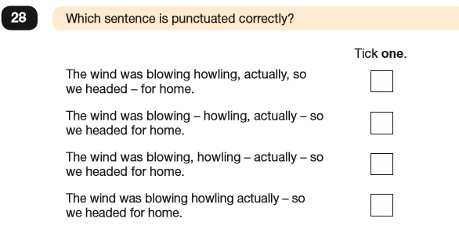

Slide 107
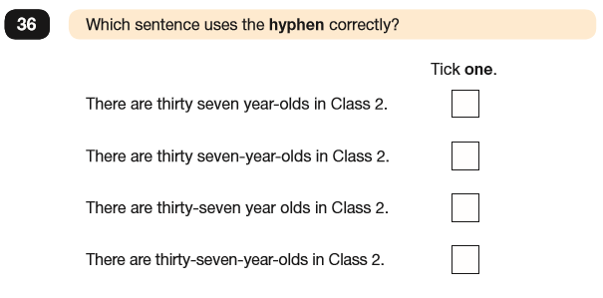

Slide 108
Just for fun: Punctuation Power
Dear John:
I want a man who knows what love is all about.
You are generous, kind, thoughtful.
People who are not like you admit to being useless and inferior.
You have ruined me for other men.
I yearn for you.
I have no feelings whatsoever when we’re apart.
I can be forever happy.
Will you let me be yours?
Gloria
Dear John:
I want a man who knows what love is.
All about you are generous, kind, thoughtful people, who are not like you.
Admit to being useless and inferior.
You have ruined me.
For other men, I yearn.
For you, I have no feelings whatsoever.
When we’re apart, I can be forever happy.
Will you let me be?
Yours,
Gloria

